Slide 1
Session 2
Preliminary to Software Testing
chengbaolei@suda.edu.cn

Slide 2
Objectives
Review of Session 1
  Why we need SQA
  Definition of SQA
  QA VS. QC
  Testing overview: what, who, when

Slide 3
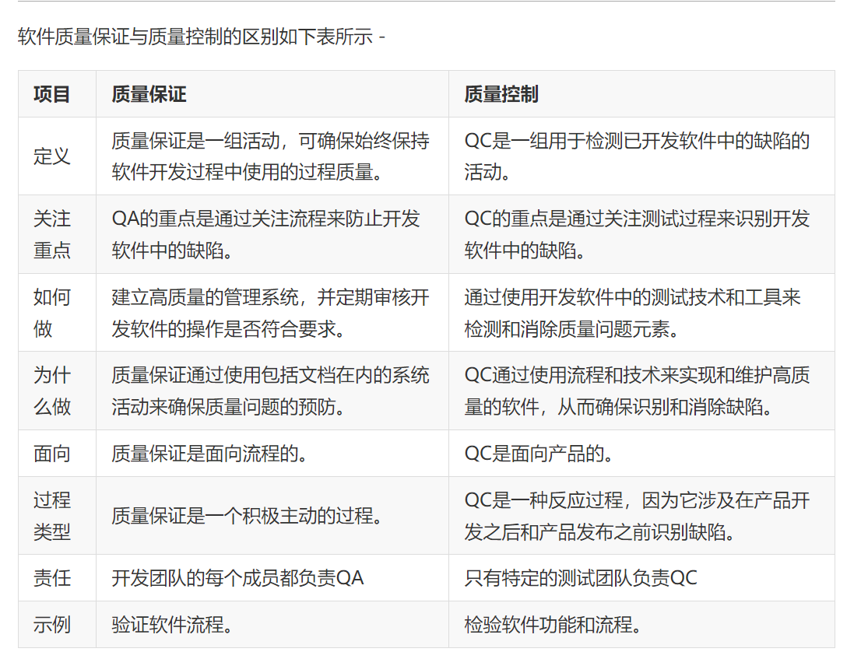
A question:
  Testing is a subset of quality assurance or quality control?

Slide 4
Objectives
In this session, you will learn:
  Comparison of some concepts
  Testing life cycle
  Model of testing
  Types of testing

Slide 5
  Comparison of some concepts
What is “defect”?
Verification / Validation
Testing / Debugging
White-box testing / Black-box testing

Slide 6
What is “defect”?
Error（错误）: occurs in the process of writing a program.
Fault（故障）: is the manifestation of one or more errors. (internal state)
Failure（失效）: occurs when faulty piece of code is executed leading to an incorrect state that propagates to the program’s output.
Incident（事故）: no message is displayed when failure occurs.
Defect (Bug)

Slide 7
void test(int iLength, char iData[ ])
0 {
1 int x=0;
2 int y=0;
3 for(int loop=0; loop<iLength; loop++)
4 {
5 if(“A”= =iData[loop])
6 x++;
7 else
8 if(“a”= = iData[loop])
9 x++;
10 else
11 y++;
12 }
13 printf（"%d,%d\n", x, y);
14 }
char iData[]=“John”
char iData[]=“Amy”
char iData[]=“Anna”
y++;

Slide 8
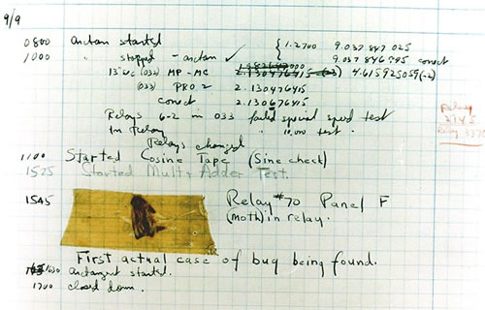
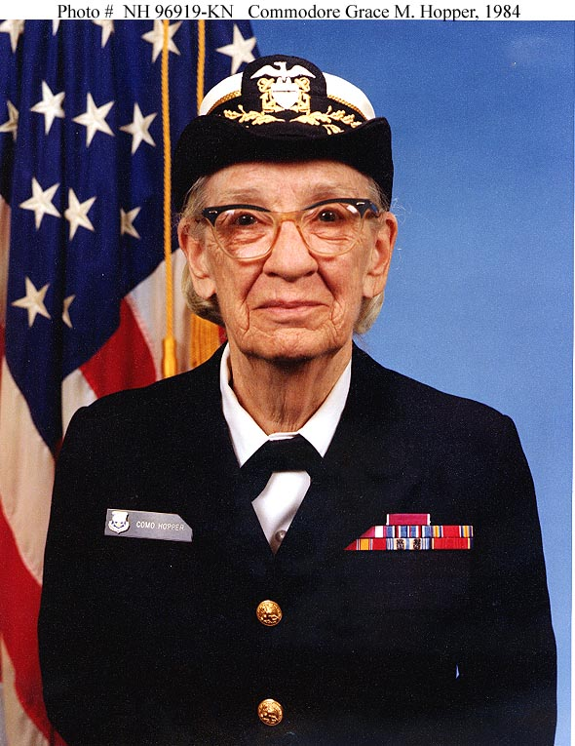
First Bug- 1947
Harvard University Mark II Aiken Relay Calculator
http://en.wikipedia.org/wiki/Grace_Hopper

Slide 9

What is “defect”?
Software defect definition
  All kinds of software problems
  Exist in code, data and documents
  Out of accord with user expectation
Notes:
缺陷的表现形式有很多种，不仅仅表现为功能失效方面，还体现在其他方面。
例如，数据结果不精确，精度不够，
实际结果和预期结果不一致，
用户界面出错、混乱、不美观，
运行中断、系统崩溃。

Slide 10
What is “defect”?
Defect example：
  Software function cannot be executed correctly
  Shortcoming
    running slowly
  Inconsistency
    Ctrl+S can’t save all applications
  User interface design defect
    an button should show 5 words on it, but only 3 words could be seen

Slide 11
Bug Kinds (diff. kinds of errors)
int square(int x) {
return x*x
}
Syntactic errors:
    Mal-formed program:
Semantic errors:
    Symbol errors
    Type errors
    Other semantic errors:
    (e.g. uninitialized vars)
Logical errors:
    Compiler: ”no errors”
*** syntax error at line 2
’;’ expected
int square(int x) {
return n*n;
}
*** symbol error at line 2
undefined variable ”n”
int square(float x) {
return x*x;
}
*** type error at line 2
function returns float, not int
int square(int x) {
return x+x;
}
no errors found!!!

Slide 12
Software Quality Attributes
  McCall (1977)
  Boehm (1978)

Slide 13
McCall's Quality Model - 1977
  Product operations (basic operational characteristics).
  The product operations perspective identifies quality factors that influence the extent to which the software fulfils its specification:
    Correctness, the functionality matches the specification.
    Reliability, the extent to which the system fails.
    Efficiency, system resource (including cpu, disk, memory, network) usage.
    Integrity, protection from unauthorized access.
    Usability, ease of use.(Usability requirements deal with the scope of staff resources needed to train a new employee and to operate the software System)

Slide 14
  Product revision (ability to change).
  The product revision perspective identifies quality factors that influence the ability to change the software product, these factors are:
    Maintainability, the ability to find and fix a defect.
    Flexibility, the ability to make changes required as dictated by the business.
    Testability, the ability to Validate the software requirements.

Slide 15
  Product transition (adaptability to new environments).
  The product transition perspective identifies quality factors that influence the ability to adapt the software to new environments:-
    Portability, the ability to transfer the software from one environment to another.
    Reusability, the ease of using existing software components in a different context.
    Interoperability, the extent, or ease, to which software components work together.

Slide 16
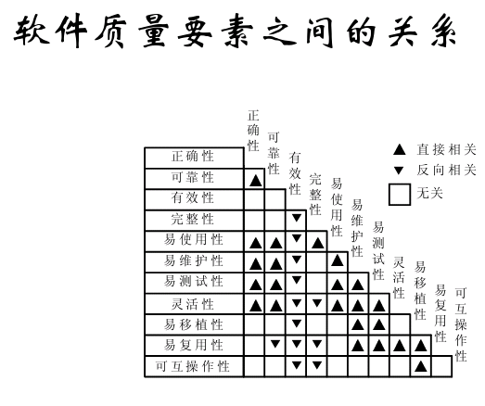

Slide 17




某软件系统的需求文档中包括规格：编程遵守公司的编码标准和指南，该需求属于哪个软件质量因素？
A. 可维护性 B. 可测试性 C. 正确性 D. 灵活性
软件质量的主要特性中，在功能改变和扩充的情况下，软件能够正常运行的能力是哪一个？
A. 可靠性 B. 安全性 C. 可扩展性 D. 功能性
某软件系统的需求文档中包括规格：普通用户可以通过Internet访问GIS（地理信息系统）文件，但不得在所访问的地图中插入更改，该需求属于哪个软件质量因素？
A. 可维护性 B. 完整性 C. 正确性 D. 灵活性
某软件系统的需求文档中包括规格：系统可在稍后经过修改后适合其它的同行单位使用，该需求属于哪个软件质量因素？
A. 可靠性 B. 安全性 C. 正确性 D. 灵活性

Slide 18


Verification vs. validation
    Verification（验证）: The software should conform to its specification
    (Are we building the product right?)
    Validation（确认）: The software should do what the user really requires
    (Are we building the right product?)
验证(verification)
客观世界
用户期望、需求
开发出的软件产品
软件需求
规格说明书
确认(validation)

Slide 19
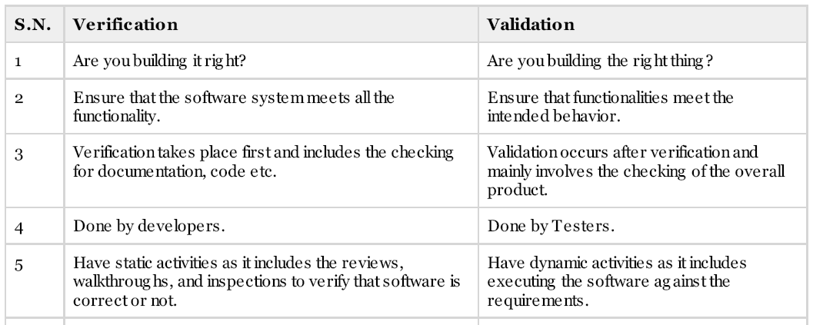
Verification vs. validation
1 meaning;
2 purpose;
3 time;
4 participant;
5 activities

Slide 20
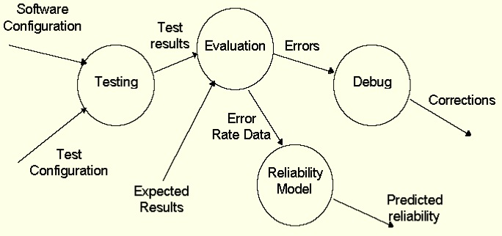
Test Information Flow
Testing vs. Debugging
Pass
Regression Testing

Slide 21
Testing vs. debugging
Testing :
It involves the identification of bug/defect in the software without correcting it.
Testing is performed in the testing phase.
Debugging :
It involves identifying , isolating and fixing the problems/bugs .
Debugging can be performed in the development phase while conducting Unit Testing
or in phases while fixing the reported bugs.

Slide 22
White-box vs. Black-box Test
Test Case:
To test whether a component conforms to project specification – Black Box Testing
To test whether a component conforms to development design – White Box Testing

Slide 23
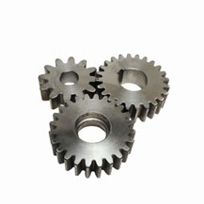

White-box vs. Black-box Test
White-box Testing:
    structural testing
    internal testing
Test focus:
    source code / design
Black-box Testing:
    behavioral testing
    external testing
    input-ouput testing
Test focus:
    specification (or intention)
n = in();
odd(n)
~
tt
ff
?
n = n/2;
n = 3*n+1;
out(n);
program
spec
Complementary Approaches!!!

Slide 24
Objectives
In this session, you will learn:
  Comparison of some concepts
  Testing life cycle
  Model of testing
  Types of testing

Slide 25
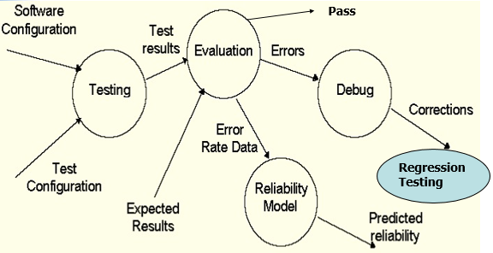
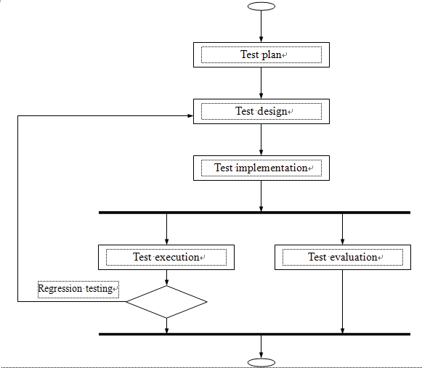
Testing Life Cycle
Analysis testing requirements;
Design test case
Prepare testing environment;
select testing tools
PDCA

Slide 26
Objectives
In this session, you will learn:
  Comparison of some concepts
  Testing life cycle
  Model of testing
  Types of testing

Slide 27


Model of testing
The V model
The W model

Slide 28
The V Model
To reduce the cost of correcting defects, the defects must be detected early in the development life cycle.
The earlier, the better.

Slide 29
The V Model
The V model proposes an approach to software development in which both the software development process and the software test process begin simultaneously.
When the project starts, the development team starts the software development process and the testing team starts planning for the test process.
This planning is based on the documents created during the development process.

Slide 30
The V Model (Contd.)
The V model places the development phases such as requirements, analysis, design, and coding on one side of the V.
The various types of testing such as unit, integration, system, and acceptance, are placed on the other side of the V.

Slide 31
The V Model (Contd.)
What is the disadvantages of the V model?
The V model focuses only on dynamic testing and does not mention the benefits and effectiveness of static testing techniques such as reviews, inspections, and static code analysis.

Slide 32
The W Model
The W model is an extension of and addresses the limitations of the V model.
It focuses on a testing methodology where static testing techniques are applied during the various stages of development. This results in tests being performed in parallel with the development process.
These techniques are cheaper and more effective than dynamic testing.

Slide 33
The W Model (Contd.)
The following figure shows the W model of testing.

Slide 34
The W Model (Contd.)
The following table describes the test activities performed in each phase of the development life cycle.
Phase of the development life cycle | Test Activity
Requirements | Test the requirements Acceptance Test Plan
High-Level Design | Test the design documents System Test Plan Integration Test Plan
Detailed Design | Test the design documents Unit Test Plan
Coding | Unit Testing
Integration | Integration Testing System Testing
Acceptance | Acceptance Testing

Slide 35
The W Model
The W model places the test process on an equal footing with the development process.
The W model adopts both of static testing and dynamic testing.
Recall verification & validation.

Slide 36
Objectives
In this session, you will learn:
  Comparison of some concepts
  Testing life cycle
  Model of testing
  Types of testing

Slide 37
  Types of testing
Types of testing
  C1:Source of test generation
  C2:Life cycle phase in which testing takes place
  C3:Goal of a specific testing activity
Notes:
C1:按照测试生成的来源
C2：按照生命周期的阶段
C3：按照测试活动的目的
C4：按被测对象的特征
C5：按测试过程的模型

Slide 38
  Types of testing
C1:Source of test generation
Artifact | Technique
Requirements (informal) | Black-box
Code | White-box
Requirements and code | Black-box and white-box
Formal model: graphical or mathematical specification | Model-based specification
Component’s interface | Interface testing

Slide 39
  Types of testing
C2:Life cycle phase
Phase | Technique
Coding | Unit testing
Integration | Integration testing
System integration | System testing
Post system, pre-release | Alpha/Beta-testing /Acceptance testing
Maintenance | Regression testing

Slide 40
  Types of testing
C3:Goal-directed testing
Goal | Technique
Advertised features | Functional
Security | Security
Invalid inputs | Robustness
Errors in GUI | GUI
Operational correctness | Operational
Reliability assessment | Reliability
System performance | Performance
Customer acceptability | Acceptance
Business compatibility | Compatibility
Peripherals compatibility | Configuration
Foreign language compatibility | Foreign language

Slide 41
  Types of testing
测试阶段或层次
验收测试
系统测试
集成测试
单元测试
方法
功能测试
强壮性测试
白盒测试
黑盒测试
性能测试
适用性测试
安全性测试
可靠性测试
目标/特性

Slide 42
Summary
In this session, you learned that:
  Comparison of some concepts
  Testing life cycle
  Model of testing
  Types of testing

Slide 43
Questions:
  1 Testing is a subset of quality assurance or quality control?
  2 Testing life cycle
  3 V model and W model

